Slide 1
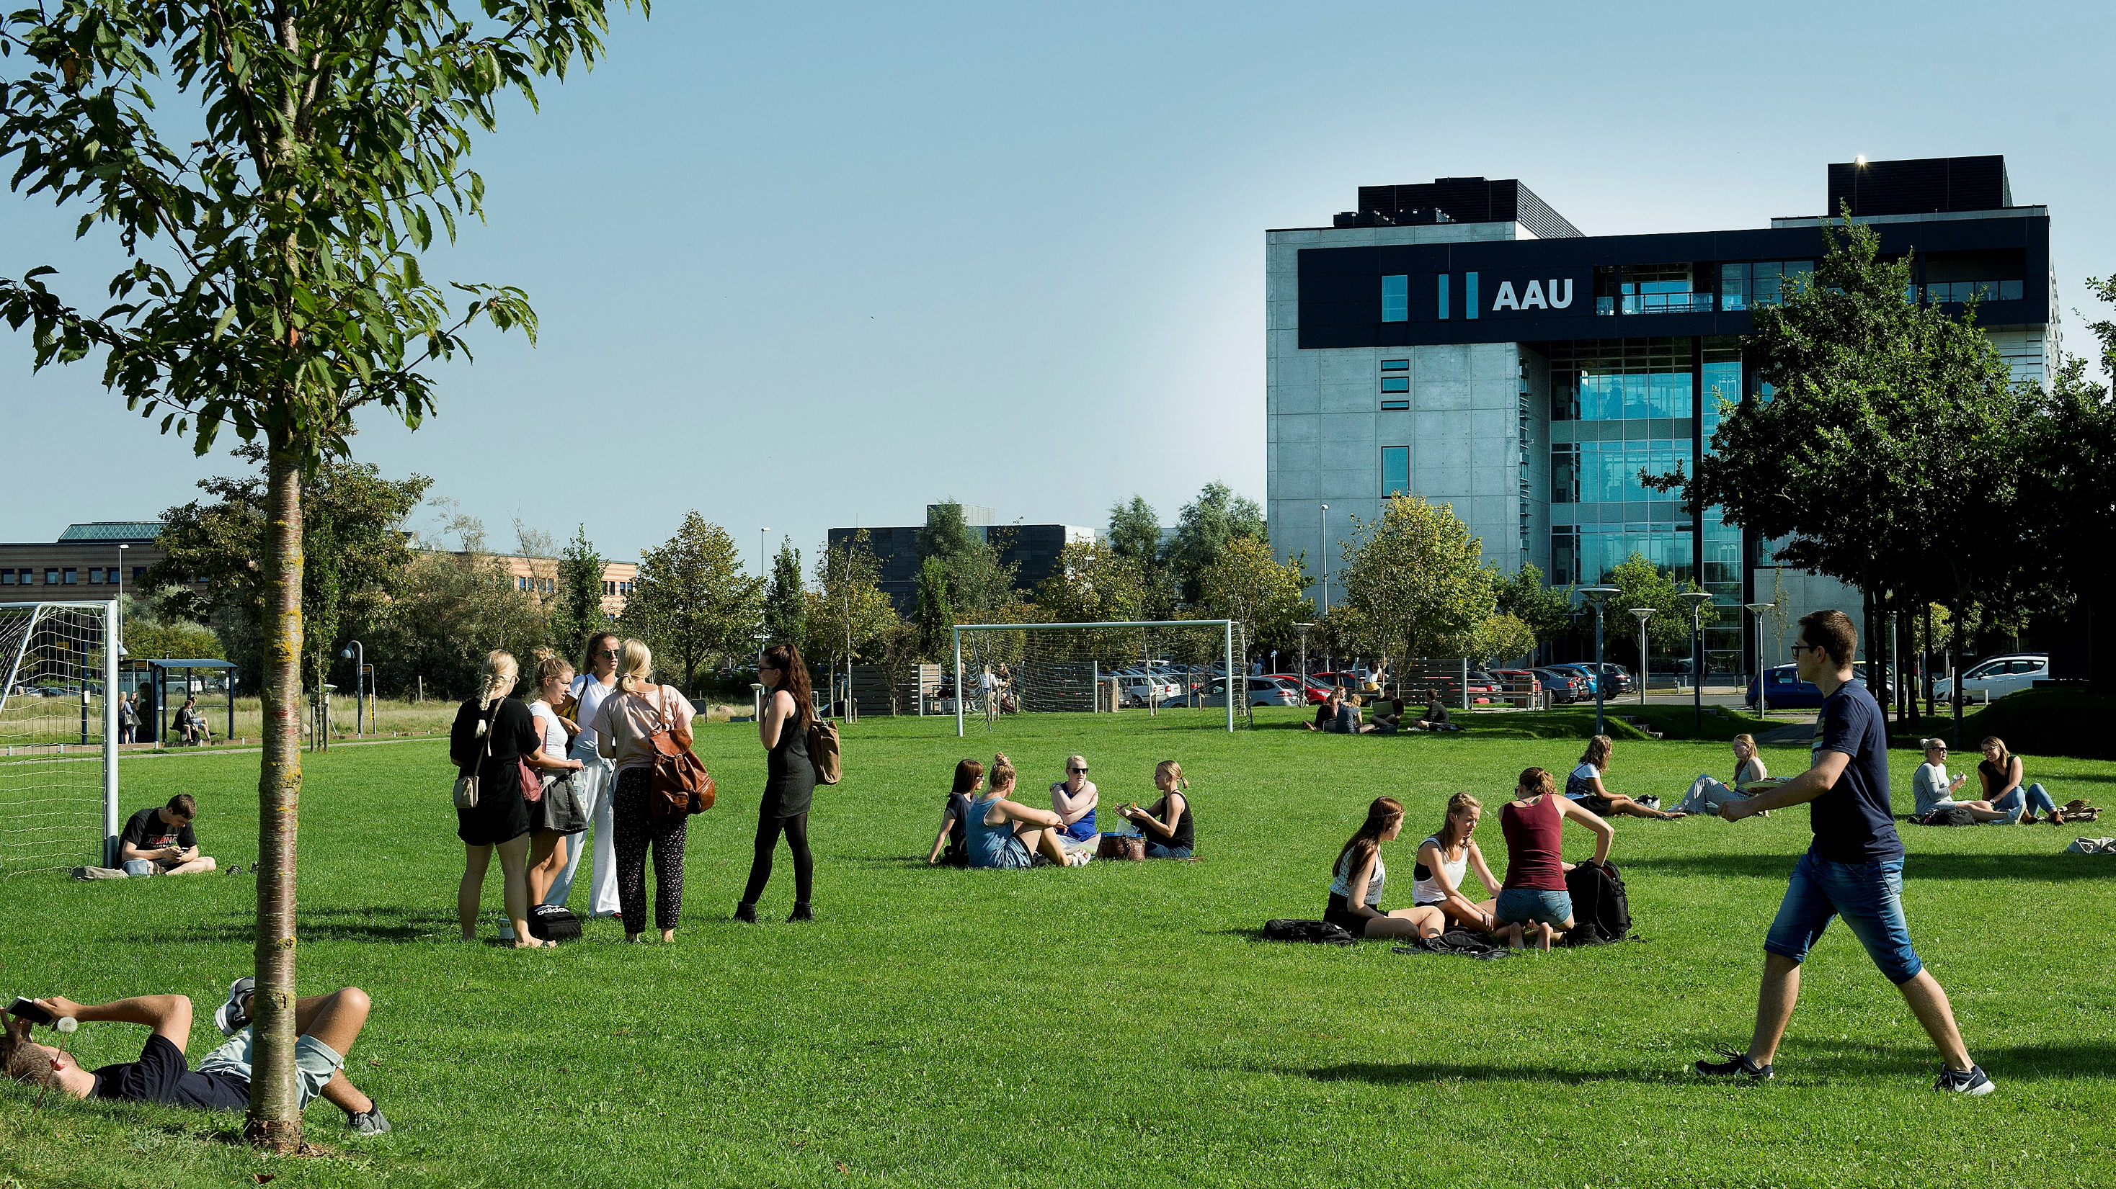

Slide 2
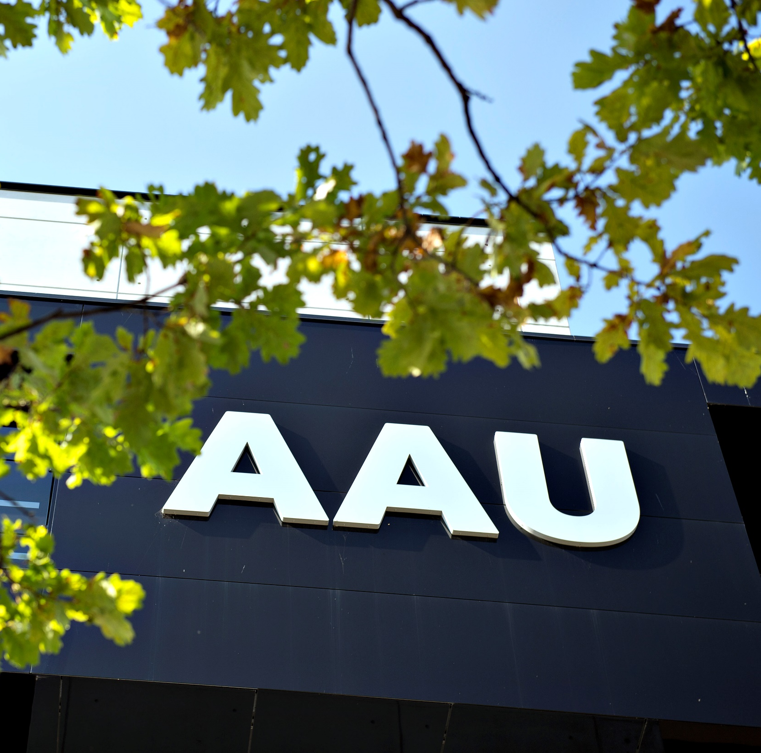
CONTENT
GENERAL GUIDELINES
STUDENTS
PBL
RESEARCH AND RANKING
BUSINESS COLLABORATION
STRATEGY 2016-21

Slide 3

AAU – KNOWLEDGE FOR THE WORLD
All degree programmes and research activities at Aalborg University are problem and project-based and have an interdisciplinary focus.
Through strong interplay between staff and students and intense collaboration with public and private sectors, we offer degree programmes with a real-world approach and provide world-class research.
This results in new insights, new solutions to societal challenges and knowledge that changes the world.

Slide 4

WHY HOLD ON TO PBL?
Students learn best when they are actively participating and apply theory and research-based knowledge to problem solving
This learning model supports the development of students' communication and collaboration skills
Students learn to take an analytical and result-oriented approach to their work
PBL provides students with tools for independent acquisition of knowledge at an advanced academic level
PBL provides students with the opportunity to cooperate with external partners on solving specific problems

Slide 5
Time Management Table
Name | Time holding breath under water | Time without criticizing work | Time used for eating
Nicolai | 29:10 | 29:10 | 20:00
Thassilo | 10:02 | 10:02 | 20:00
Aitor | 00:17 | 00:17 | 20:00
Nicolas | 19:57 | 00:00 | ∞

Slide 6
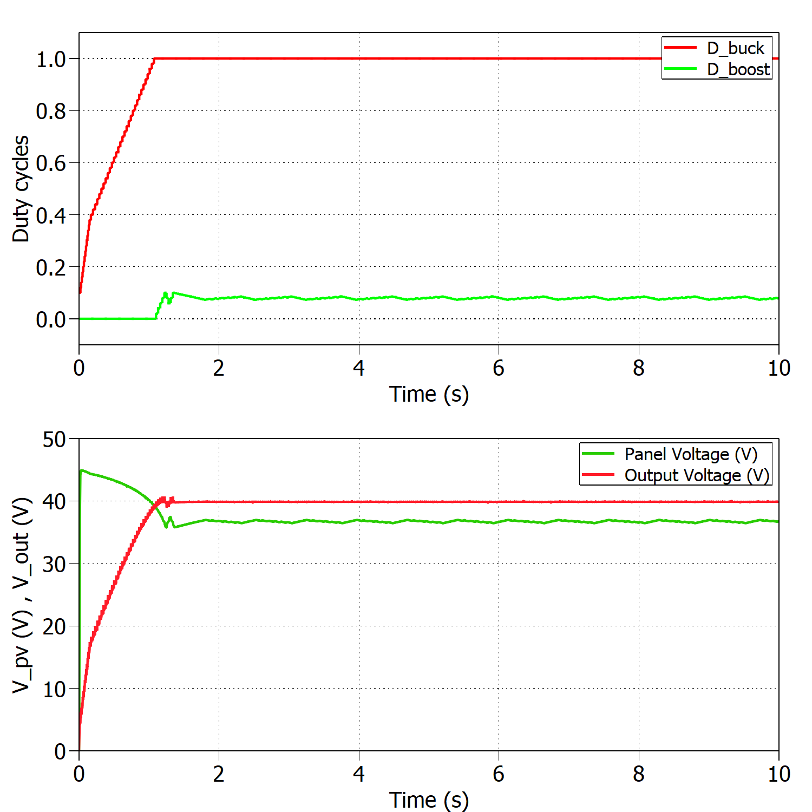
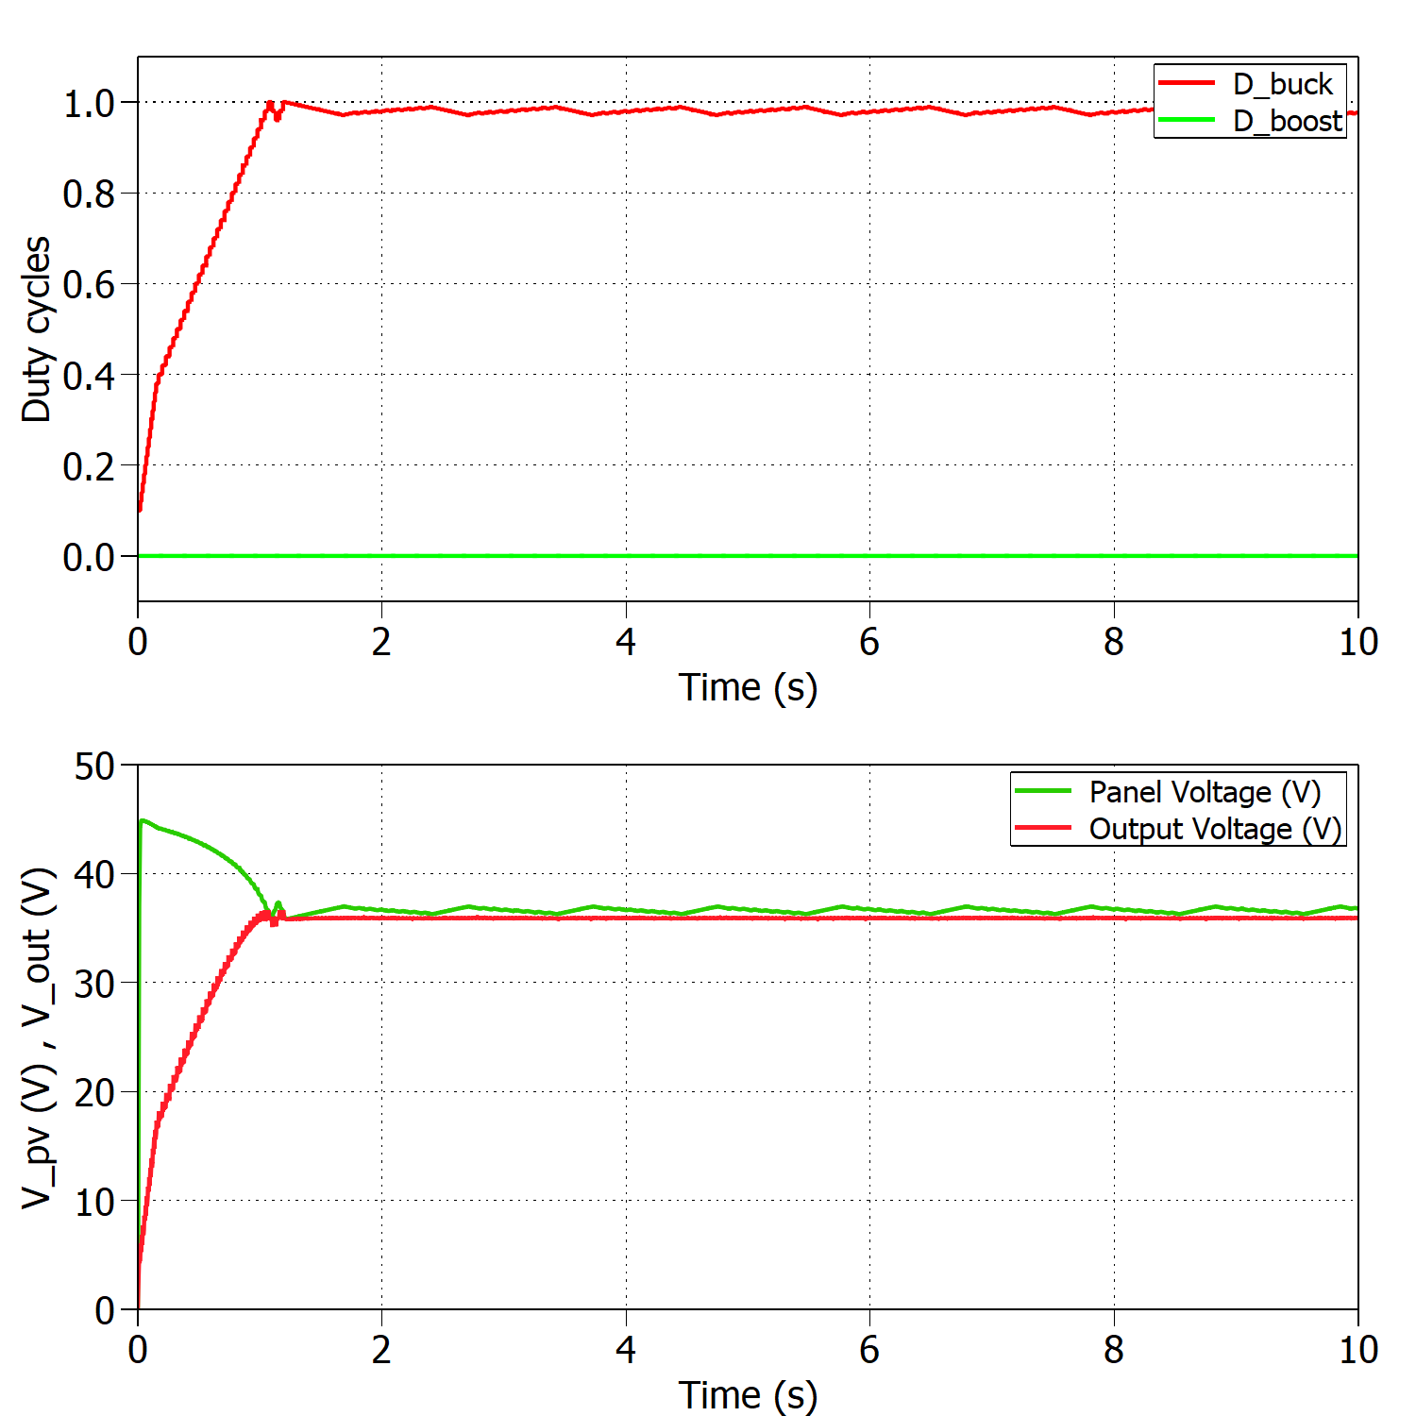
Time Management Table
Add a nice looking caption if you have multiple figures at one slide
And make sure that they are better aligned than this…

Slide 7
Example for having a lot of points at the slide
Use these nice arrows to divide the points
Strong roots and commitment to the region
Sharp focus on developing new forms of interaction and new methods for facilitating knowledge collaboration (AAU is often a first mover in Denmark)
Flexible and accommodating in terms of engaging in cooperation agreements

Slide 8

KNOWLEDGE COLLABORATION

Slide 9
COLLABORATION WITH INNOVATIVE DANISH COMPANIES (2006-15)
Almost one in ten Danish-based innovative companies has entered into cooperation with AAU
Notes:
Note: The figures are based on the R&D&I statistics 2008-2015 and include all companies having engaged in innovation activities in this period. In order to be included in the figures, companies must have engaged in collaboration with a university at least once during the period in question.
Source: IRISgroup, ‘Aalborg Universitets vidensamabarbejde – effekter for virksomheder, myndigheder og samfund’ [Aalborg University’s knowledge collaboration – effects for companies, public authorities and the society], June 2017

Slide 10
DEVELOPMENT OF THE NUMBER OF LICENSE, SALES AND OPTIONS AGREEMENTS
Vast increase in the amount of technology transfers at AAU
In 2014, Aalborg University entered into almost the same number of license, sales and options agreements as did the other seven Danish universities put together
Notes:
Note: Calculation performed on the basis of the technology transfer statistics
Source: IRISgroup, ‘Aalborg Universitets vidensamabarbejde – effekter for virksomheder, myndigheder og samfund’ [Aalborg University’s knowledge collaboration – effects for companies, public authorities and the society], June 2017

Slide 11


